Slide 1
TOCQ: Tackle Opportunity Containment Quotient Duke MSS Portfolio Presentation
By Eli Gnesin
STA 583
April 5, 2024

Slide 2

The Big Data Bowl
Hosted by the National Football League
Amazon “Next Gen Stats” player tracking data
2024 theme: Tackling

Slide 3
Motivation and Introduction
Goal of football: Offense wants to advance ball
Defense wants to tackle ball carrier
Box score only credits player who “made the tackle”
Want metric to evaluate:
Players who see opportunities “slip away”
Players who are “in the right place at the right time”
Motivating Play: Week 2, 2022: New York Jets-Cleveland Browns

Slide 4
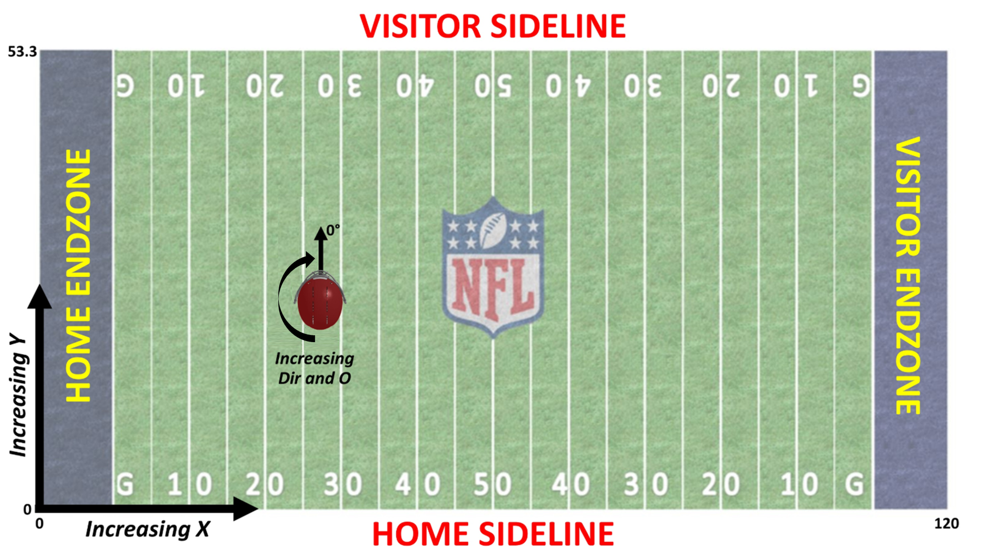

The Data
Weeks 1-9, 2022 NFL Season
Player and Ball tracking data
Speed, Acceleration, Direction
$(x,y)$ location
Player Orientation
10 Frames/Second (subset)
Game, Player, Play information

Slide 5
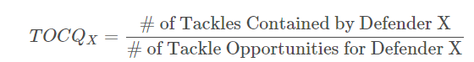
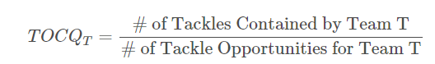

Defining TOCQ
Tackle Zone: Radius $r$, 150 degree sector angle
$r=\max\left(1.25, 1.25+st+ \frac{1}{2}at^{2}\right), t=0.1$
Tackle Opportunity: Ball enters zone during play
Tackle Contained: Play ends in tackle zone
All tackles contained are tackle opportunities

Slide 6
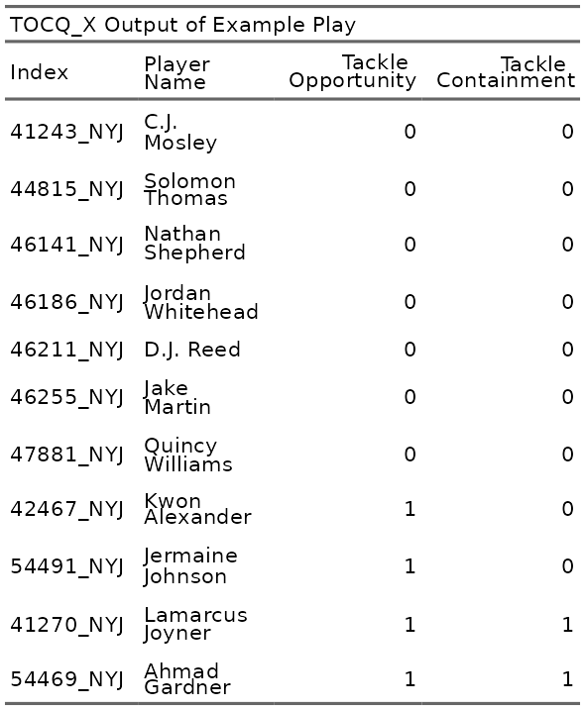
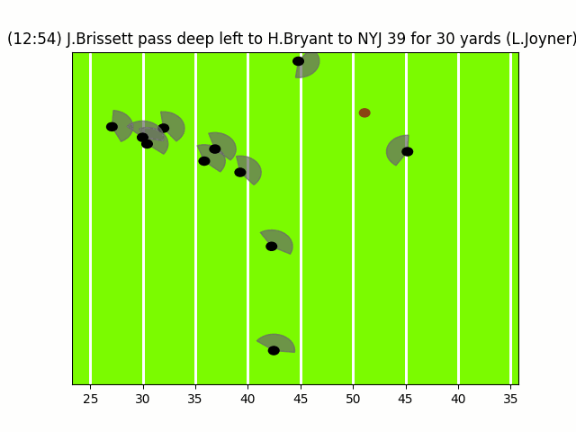
Visualizing TOCQ

Slide 7
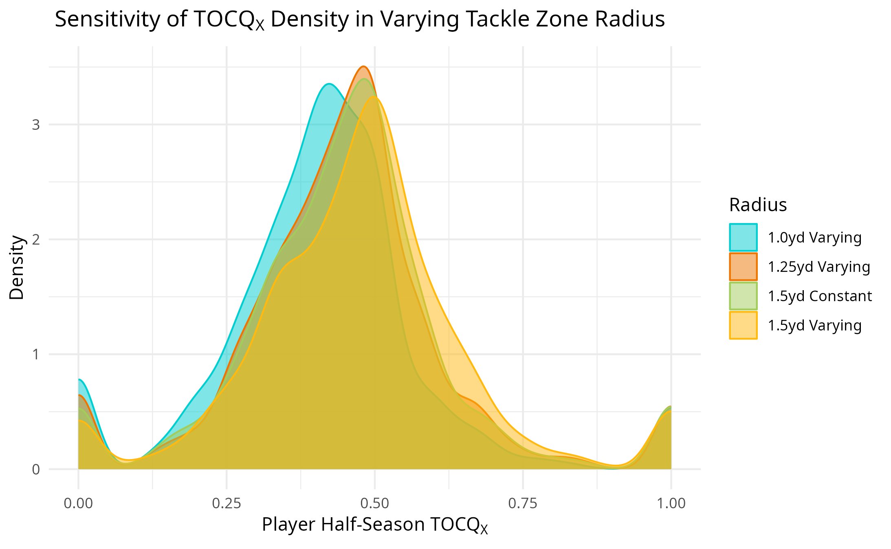
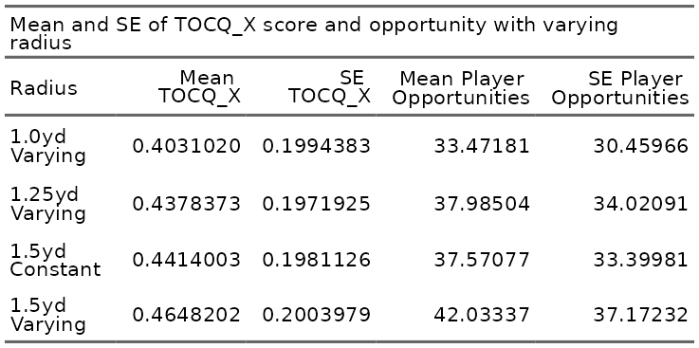
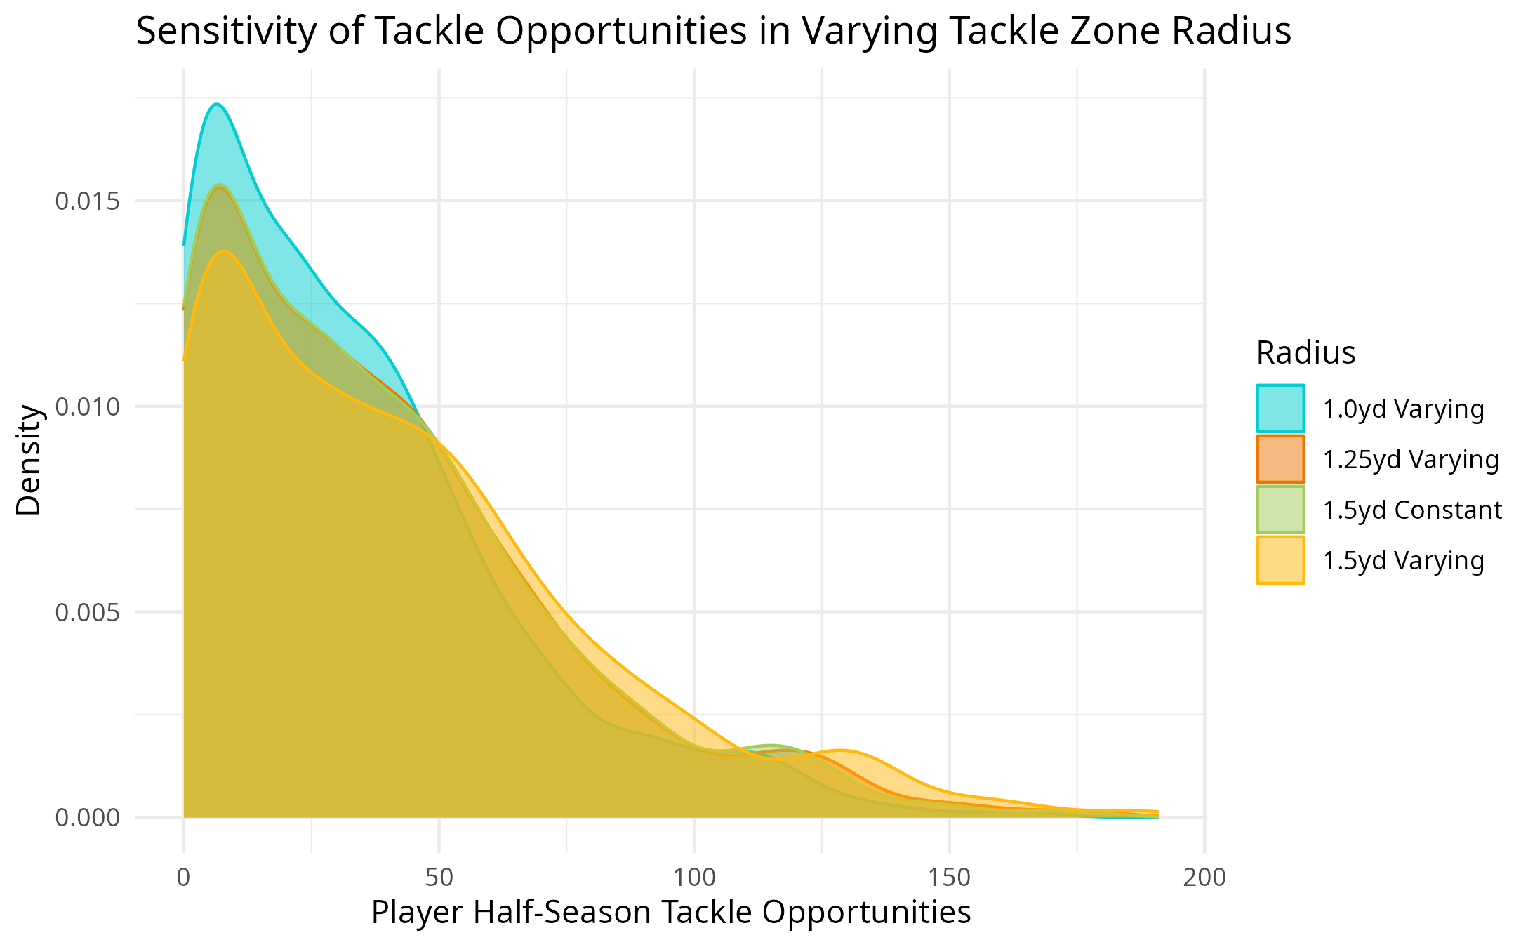
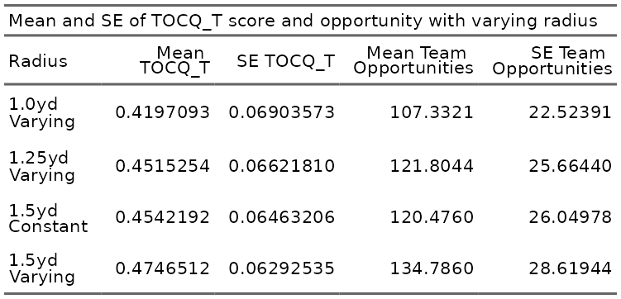
Radius Sensitivity

Slide 8
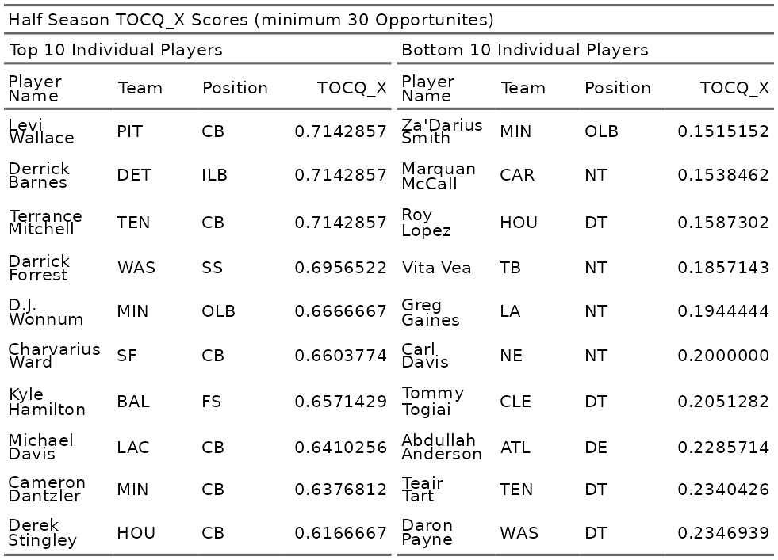
Player TOCQ (Half Season)

Slide 9
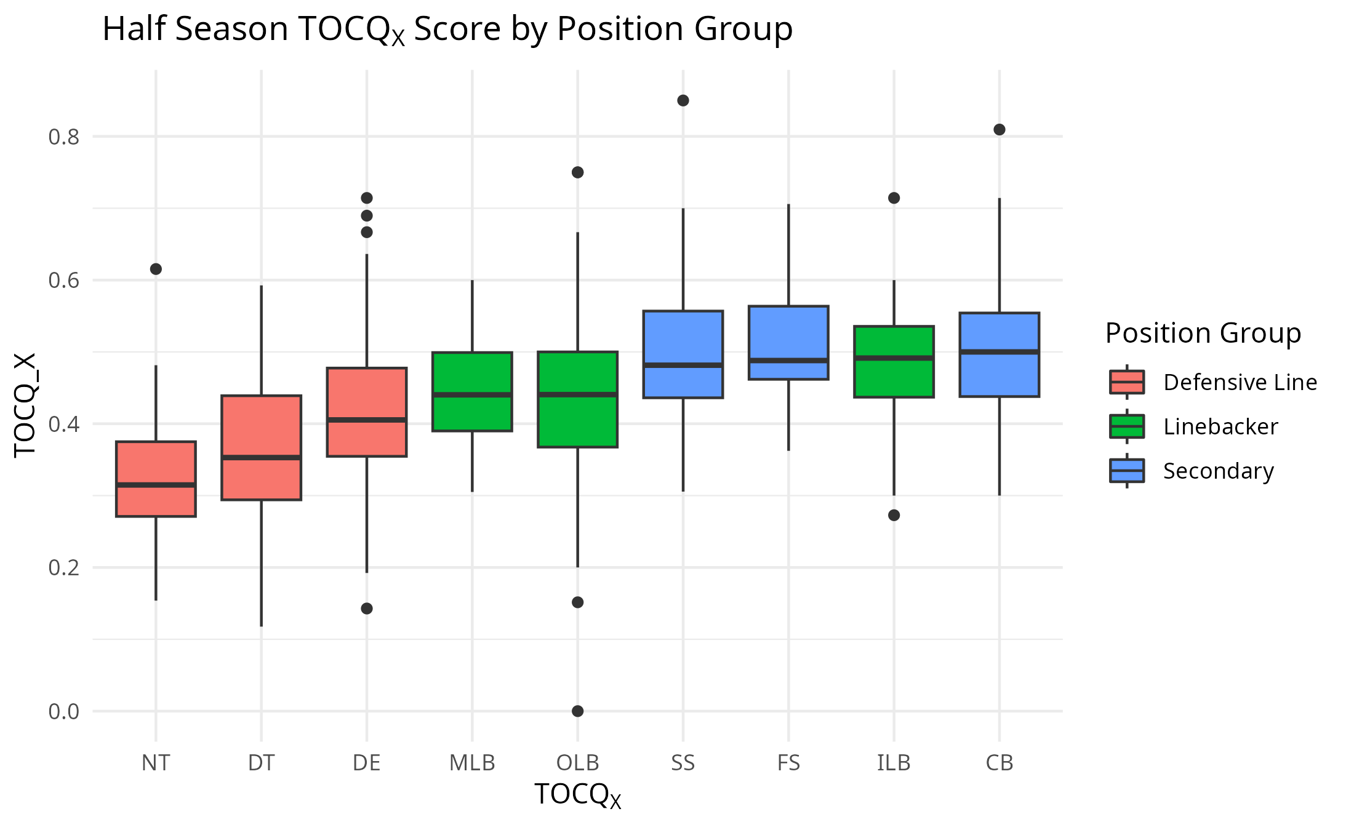
Player TOCQ (Position Group)

Slide 10
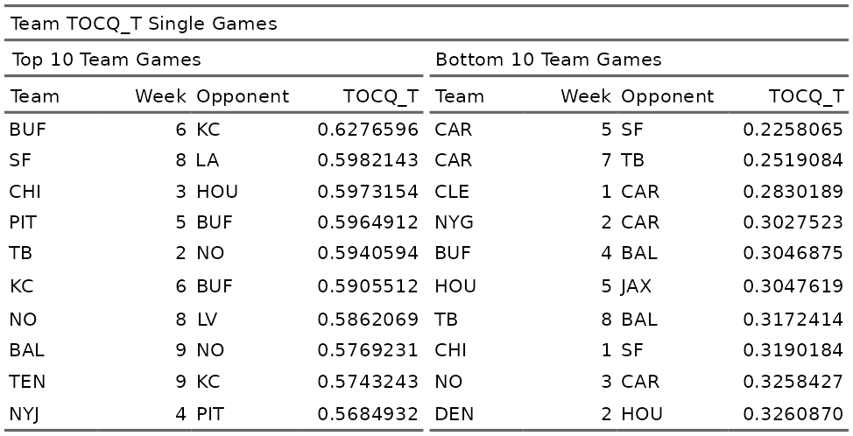
Team TOCQ (Game)

Slide 11
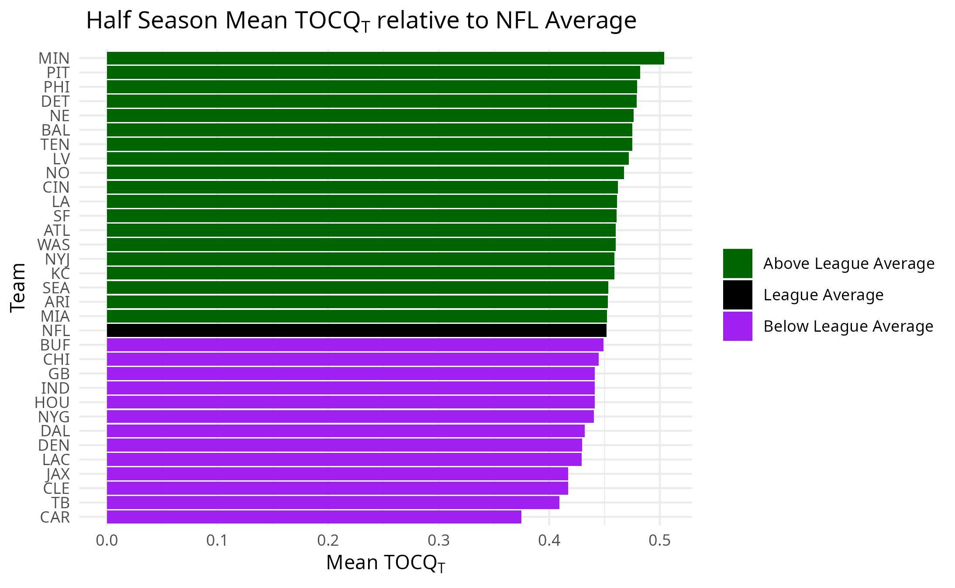
Team TOCQ (Half Season)

Slide 12
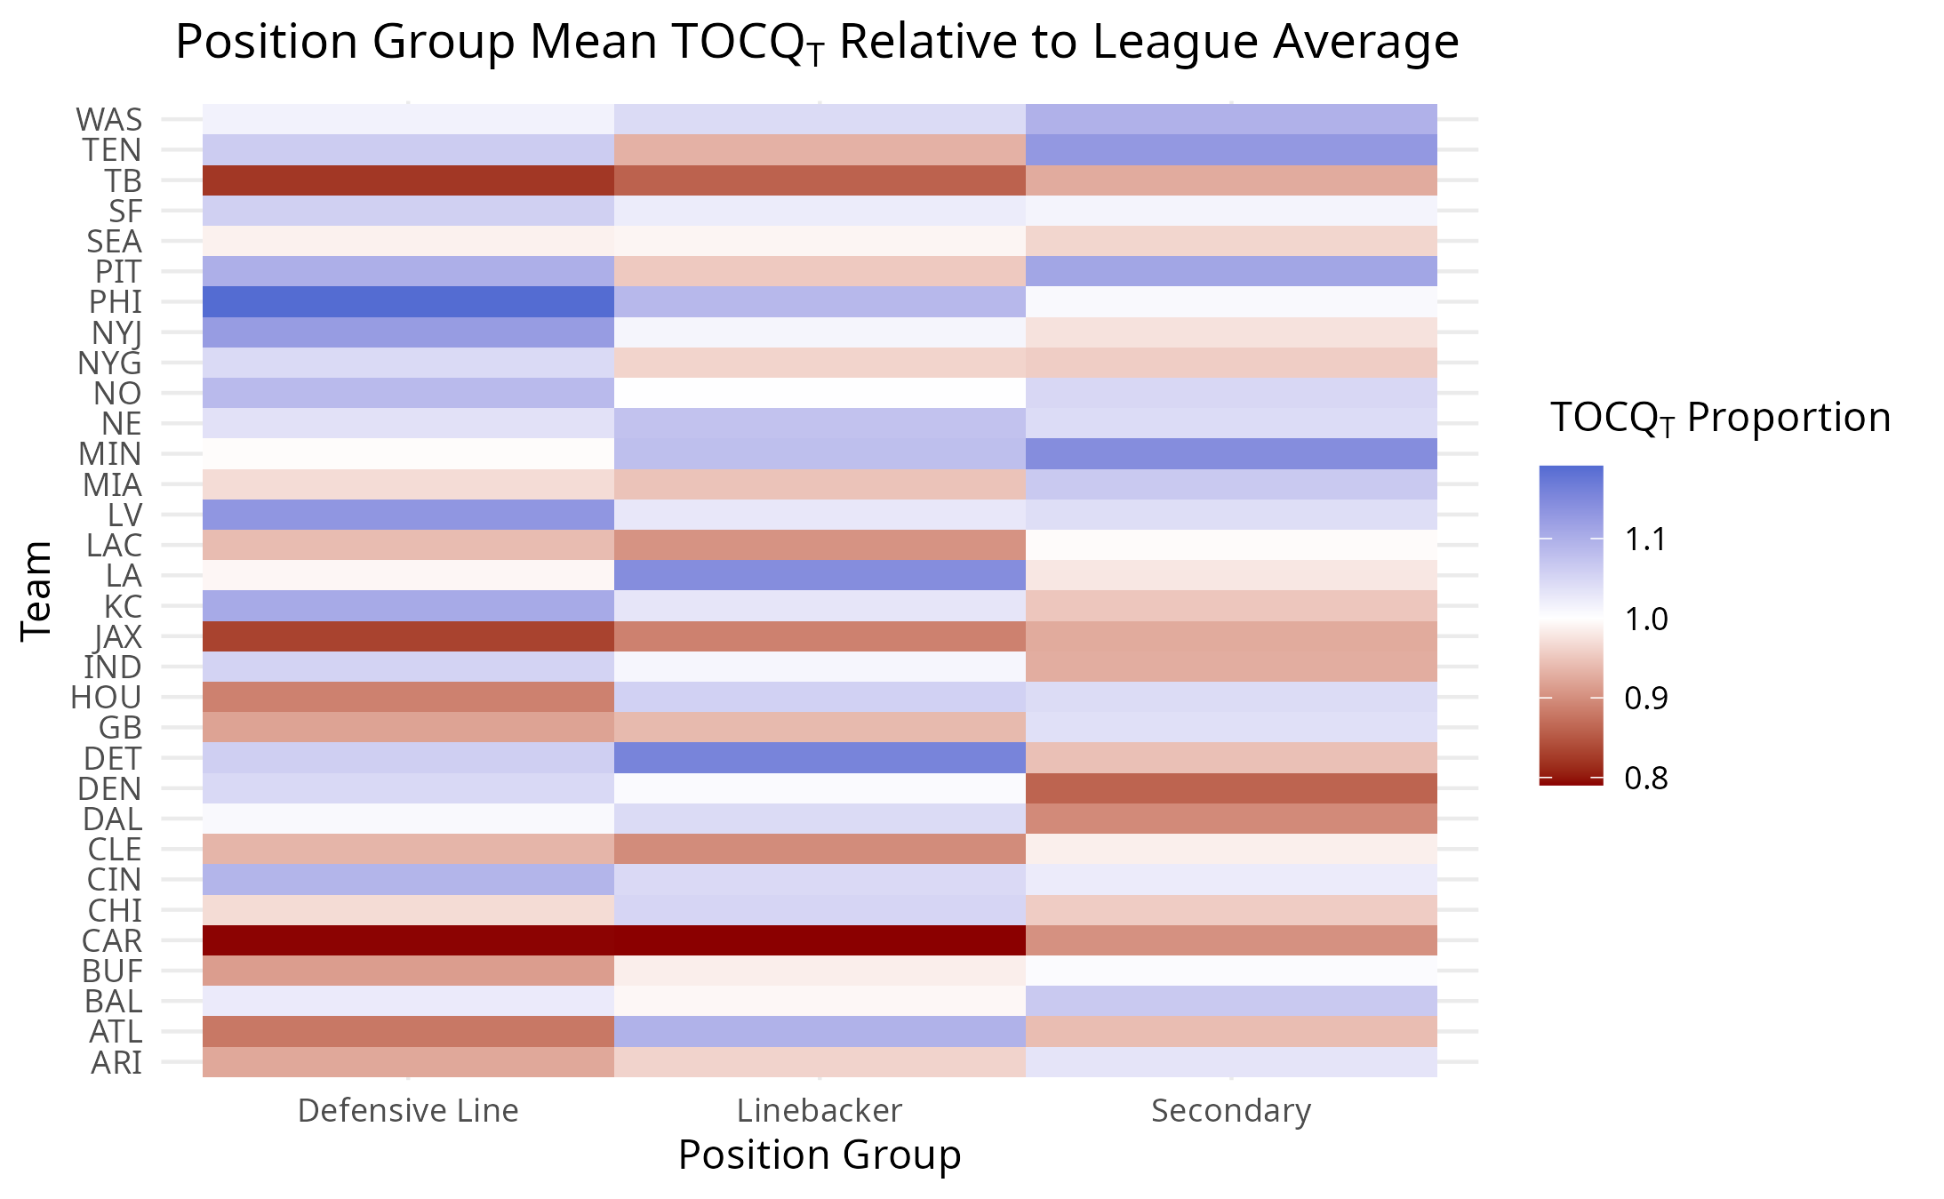
Team TOCQ (Position Group)

Slide 13
Conclusion
Introduced TOCQ with team and player parametrizations
Tackle zone radius has minimal impact on TOCQ scores, larger impact on # of opportunities
Defensive linemen have lower TOCQ, secondary players have higher TOCQ (in general)
Top teams tend to have higher TOCQ, lower teams tend to have lower TOCQ

Slide 14
Limitations and Future Steps
9 weeks of data = 12500 plays
2 players have 30 opportunities in a game
Team sample size of 8-9
Frame event inconsistency
Pass and run plays have different frame sets
Missing pass rush events that did not result in sacks
Unclear how event tagging was done
Blocker presence is ignored
Consider predictive approach (Predicting who picks up a tackle containment on a play)

Slide 15
Questions?

Slide 16


